Slide 1

How to Use Trace32 Simulator To
Debug MMI Critical Exception
XXX方案沟通会
展讯通信市场部
2005.11.1
Bin.ji
2012.7.3

Slide 2
Summary
This article describes how to use Trace32simulaotor toolkits to debug MMI critical exception bugs.
To make the discussion concrete, it’s recommended to read the bug examples and practice by yourself.

Slide 3
Table of Content
1. Analysis of Assert info
2. Debug tools
3. Techniques: Analysis of stack and PC context
4. One example
5. Other Debug Techniques
6. frequencely: Data structures，global variable and Traces
7. Debug system knowledge
8. Appendix

Slide 4
Analysis of Assert info
When a critical exception occors, Log tool will record .ass, .mem, and etc files.
In the .ass file, you can see a lot of Assert information and can analyse it. The most important information is “exception describe” just like:
Current Version:
…
File: RTOS/source/src/c/threadx_os.c
Line: 682
…

Slide 5
Analysis of Assert info
a) File:sci_mem.c Line:536 ASSERT(ASSERT:Error 0xff, Normal error, mmiim_touch_ime_cstar.c line=5322, param=0x1B30)
（bug1102）
This sentenece tell you the assert occors at
filename: mmiim_touch_ime_cstar.c
fileline: 5322.

Slide 6
Analysis of Assert info
  b) File: boot_mode.c
Line: 144
PASSERT(0)
> Unexpectly PC set to 0
pc jump to zero address, for example: funtion pointer=0.Normally, using Debug tools to genereate callback, you can find the bug reason . Bug3341 is a little different.

Slide 7
Analysis of Assert info
  c) Exception at 0x00008008
ASSERT(Reserved exception handler !)
（bug2285）
Pc jump to 0x00008008 address. Normally, In the PC context, there is a instruction of jump to register（ As:bl r3），In C-code there is a instruction of function-pointer.

Slide 8
Analysis of Assert info
  d) Exception at 0x000f2c4c
ASSERT(Abort exception handler !)
Abort fault(DFSR:0x00000005): Translation fault, Domain invalid !
Fault address :0xb194423c
（bug3009）
PC run to 0x000f2c4c address(such address is usually in driver code). Normally, Using Debug tools to genereate callback, you can find the bug reason.

Slide 9
Analysis of Assert info
Because 0x5 is not divided by 2, write to or read from 0x5 address will cause a exception like this.

Slide 10
Analysis of Assert info
  e) Exception at 0x08655b4a
ASSERT(Abort exception handler !)
Abort fault(DFSR:0x00000001): Alignment fault, Domain invalid !
Fault address :0x000005b6
（bug1557，bug1806）
PC run to 0x08655b4a address(such address is usually in mmi code). Normally, Using Debug tools to genereate callback, you can find the bug reason.

Slide 11
Analysis of Assert info
  f) Exception at 0x09045f4e
ASSERT(Abort exception handler !)
Abort fault(DFSR:0x0000000d): Permission fault, Domain valid !
Fault address :0x0000006c
（bug2573）
The same to e).

Slide 12
Analysis of Assert info
  g) Exception at 0x044d11a8
ASSERT(Abort exception handler !)
Abort fault(DFSR:0x0000000d): Permission fault, Domain valid !
Fault address :0x00007824
（bug2708，bug1916，bug1571）
PC run to 0x044d11a8 address(such address is usually in memorymanager code). Normally, Use Debug tools to genereate callback to try to find the bug reason.

Slide 13
Analysis of Assert info
  h) Div 0, retarget
（bug1817）
Div 0 error, Normally, Using Debug tools to genereate callback and PC context, you can find the bug reason.

Slide 14
Analysis of Assert info
  i) [Monkey test] In autotest, screen display stopped, and phone was not responsing, assert manually.
（bug1405）
Sometimes Using Debug tools to genereate callback, you can find some loops. Sometimes Analyzing the log file(*lst) can help to find the exption reason.

Slide 15
Analysis of Assert info
  j) sci_mem.c Line: 177 [0x040ddd54] had been freed pointer!.
（bug2006）
The code is using freed pointer. Usually it is need to check the program flow to find the reason. Sometimes it is because memory overlay.

Slide 16
Analysis of Assert info
  k) ASSERT(ASSERT: Error 0x10,No memory, unable to allocate,mmikm_playlist.c, line=2393, param=0x1B0D0).
（bug1035）
The memory is not enough. First it is need to check whether there is memory leak(there is many same memory print line in .ass file).Otherwise it is need to check the “space” occpy infomation in *.ass file and check what the current window(from s_zorder_system global variable) is doing.

Slide 17
Analysis of Assert info
  l) File: watchdog.c
  Line: 312
  PASSERT(SCI_FALSE)
Task APP timeout
（bug1321）
Usually Using Debug tools to genereate callback, you can find the reason.Sometimes t_p_app task is getting mutex or semphore，sometimes there is loop in t_p_app task callback）.

Slide 18
Analysis of Assert info
  m) File: RTOS/source/src/c/threadx_os.c
Line: 677
ASSERT(ASSERT: Error 0xb,The queue was full)
（bug2930）
just like l).

Slide 19
Analysis of Assert info
  n) File: prod_param.c
Line: 731
PASSERT(0)
Stack Overflow,thread:0x45c0994,sp overflow addr:0x402a928,thread ID:0x15,Tx Name:T_P_APP
（NEWMS00199242）
Usually there are two reasons causing such bugs：callback is too deep(or there are loops)，local variable size is to big.

Slide 20
Table of Content
1. Analysis of Assert info
2. Debug tools
3. Techniques: Analysis of stack and PC context
4. One example
5. Other Debug Techniques
6. frequencely: Data structures，global variable and Traces
7. Debug system knowledge
8. Appendix

Slide 21
Debug tools
The Debug toolkits (developed by lianxiang)：
trace32cmm_auto.bat //generate callback
t32_stack_maker.bat //generate callback of all except current task
mem_statist.bat //generate memory occupy
dbg_stack_make_call_list.bat //generate call list mapping

Slide 22
Table of Content
1. Analysis of Assert info
2. Debug tools
3. Techniques: Analysis of stack and PC context
4. One example
5. Other Debug Techniques
6. frequencely: Data structures，global variable and Traces
7. Debug system knowledge
8. Appendix

Slide 23
Analysis of stack and PC context
Copy trace32cmm_auto.bat, bug123.ass, bug123.mem, and bug123.axf in the same directory，double click trace32cmm_auto.bat to execute， t32.cmm file will be generated and overwrite the same file in c:\t32\t32.cmm. Run trace32simulator to open the debug inteface.Then the stack(or callback) and PC context can be generated.
(below, Take current task being app task as an example. )

Slide 24
Analysis of stack and PC context
Usually the program callback will automaticly show when the debug interface opens.
If the callback can not be seen（for example，the app task info not printed in ass file），it can be find by check s_static_thread_ptr_table variable（bug2285）.

Slide 25
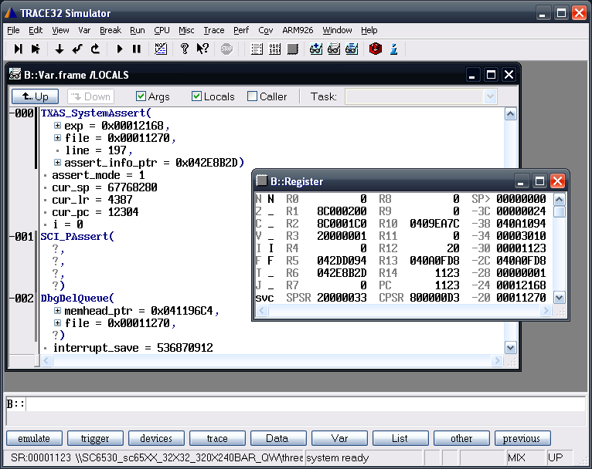
Analysis of stack and PC context

Slide 26
Analysis of stack and PC context
As we know, thread_id=21 in s_static_thread_ptr_table is t_p_app task：
s_static_thread_table =...
tx_stack_ptr _=_0x04032E80,
tx_stack_start = 0x04030684,
tx_stack_end = 0x0403367F,

Slide 27
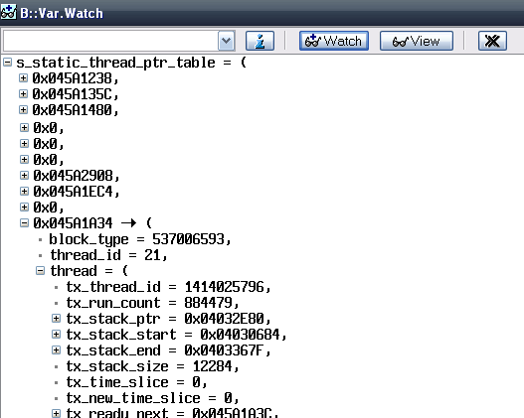
Analysis of stack and PC context

Slide 28
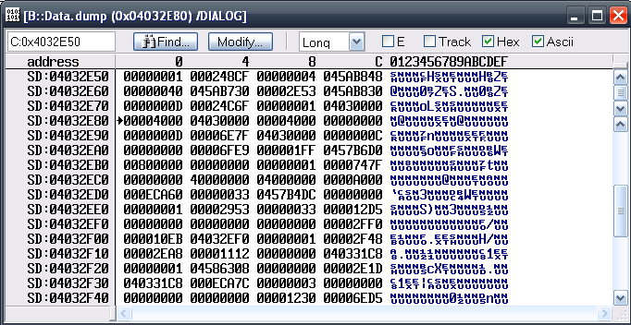
Analysis of stack and PC context
What tx_stack_ptr records is current stack address，its content can be seen in data.dump, tx_stack_ptr=0x04032E80, as below,

Slide 29
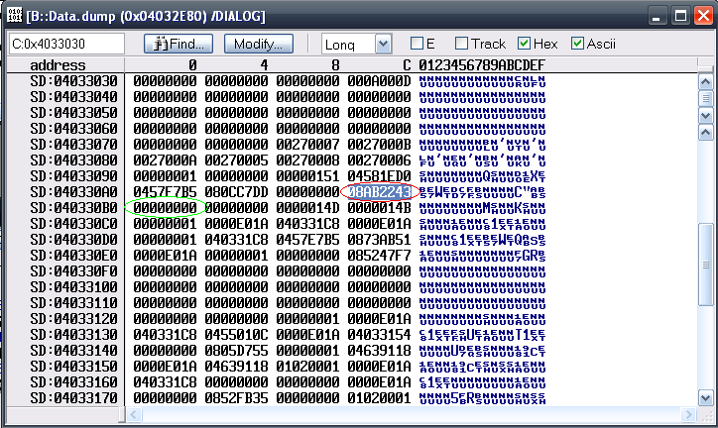
Analysis of stack and PC context
From this address to stack_end address, find the value just like 0x08**，take the value as pc register，the next address as r13 register, as the below graph show，pc= 0x08AB2243，r13= 0x40330B0

Slide 30
Analysis of stack and PC context
It is way by invert searching (from tx_stack_ptr to tx_stack_end)，it can be searched from tx_stack_end to tx_stack_ptr. However，we find the r13 register and pc register value：r13=040330B0，pc=08AB2243. put them into the two registers, callback will display（it should be checked by：in Indirect List, the function context can be seen, and the called next function address can be seen;

Slide 31
Analysis of stack and PC context
on the other hand, from the called next function stack address, by assemble code, calculating the prev function address will match the known address.

Slide 32
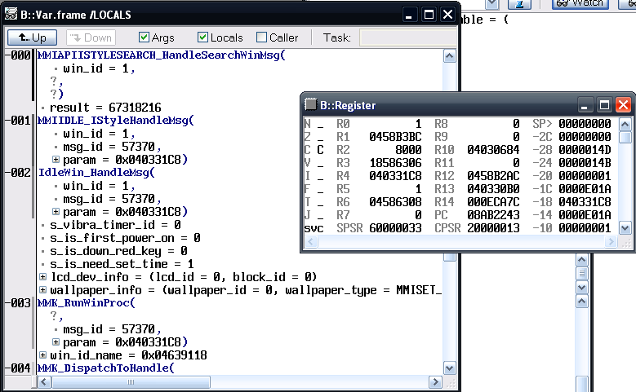
Analysis of stack and PC context

Slide 33
Analysis of stack and PC context
When the complete callback is generated, we get a lot of information: the current window, the program flow, and the program flow param(sometimes not exactly). Then more deep stack search can be done from current r13 value to tx_stack_ptr. Or put the params to test program flow（It will be discussed below）.
Adding s_zorder_system and log file information, we can do more analysis and do winsimu test.

Slide 34
Analysis of stack and PC context
Besides the stack information, the PC context information is also important. Some bugs like Exception at 0x08***，the PC context(the code around PC addresss) can be checked，just like bug1806.
Exception at 0x0820a9be
ASSERT(Abort exception handler !)
Abort fault(DFSR:0x0000000d): Permission fault, Domain valid !
Fault address :0x00000210

Slide 35
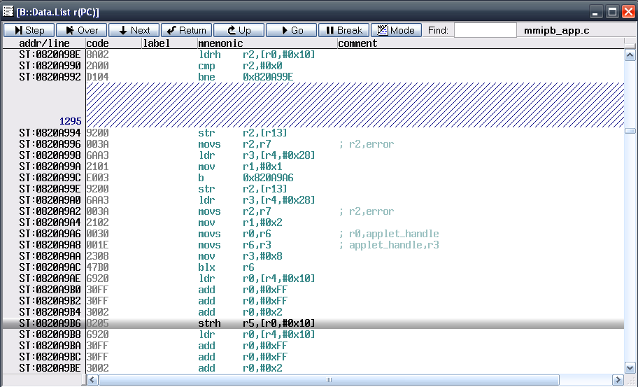
Analysis of stack and PC context
0x0820a9be-8 as pc value

Slide 36
Analysis of stack and PC context
It can be seen that PC context is around mmipb_app.cLine1295，the exception reason can be easily find from checking assembly-code and c-code.

Slide 37
Table of Content
1. Analysis of Assert info
2. Debug tools
3. Techniques: Analysis of stack and PC context
4. One example
5. Other Debug Techniques
6. frequencely: Data structures，global variable and Traces
7. Debug system knowledge
8. Appendix

Slide 38
One example（bug2285）
Previous callback generated is as below

Slide 39
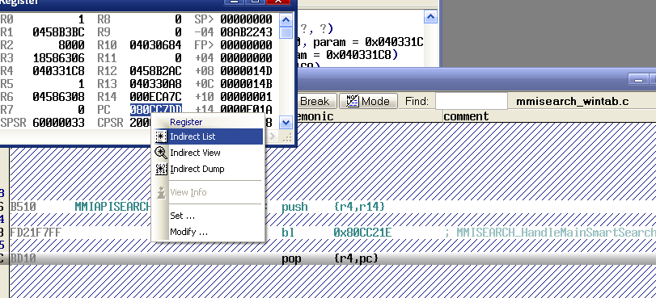
One example（bug2285）
Then，from the pc indirect list, find the code context，here it is
ST:080CC7D8FD21F7FF bl 0x80CC21E ;

Slide 40
One example（bug2285）
Enter funtion MMISEARCH_HandleMainSmartSearchWinMsg. Then what happened in MMISEARCH_HandleMainSmartSearchWinMsg ？Now it is need to find the correct params, and put them to run the program flows.
LOCAL MMI_RESULT_E MMISEARCH_HandleMainSmartSearchWinMsg(
MMI_WIN_ID_T win_id,
MMI_MESSAGE_ID_E msg_id,
DPARAM param)

Slide 41
One example（bug2285）
There are 3 params，the correct value can be generated by analyzing of register pushstack，or finding the params in calling funtion . Here 3 params can be seen in MMIIDLE_IstyleHandleMsg：win_id = 1，msg_id = 0xE01A，param = 0x040331C8.
-000|MMIAPISEARCH_HandleControlMsg(
| ?,
| ?,
| ?)
| return = 1
-001|MMIAPIISTYLESEARCH_HandleSearchWinMsg(

Slide 42
One example（bug2285）
| win_id = 1,
| ?,
| ?)
| result = 0
-002|MMIIDLE_IStyleHandleMsg(
| win_id = 1,
| msg_id = 0xE01A,
| param = 0x040331C8)
-003|IdleWin_HandleMsg(
.

Slide 43
One example（bug2285）
There is a long switch case in MMISEARCH_HandleMainSmartSearchWinMsg，but as we know, msg_id = 0xE01A，SO just analyzing case MSG_CTL_LIST_NEED_ITEM_DATA: is OK. As the code, enter SetSearchListItemData

Slide 44
One example（bug2285）
LOCAL MMI_RESULT_E MMISEARCH_HandleMainSmartSearchWinMsg(
MMI_WIN_ID_T win_id,
MMI_MESSAGE_ID_E msg_id,
DPARAM param)
{
switch(msg_id)
{
case MSG_OPEN_WINDOW:
...
case MSG_CTL_LIST_NEED_ITEM_DATA:
SetSearchListItemData((GUILIST_NEED_ITEM_DATA_T*)param);
break;
...
}
}

Slide 45
One example（bug2285）
Put the params into funtion SetSearchListItemData to continue

Slide 46
One example（bug2285）
LOCAL void SetSearchListItemData(GUILIST_NEED_ITEM_DATA_T *need_item_data_ptr )
{
MMISEARCH_MATCH_ITEM_T *match_item_ptr = PNULL;
uint16 pure_list_index = 0;
if(PNULL == need_item_data_ptr)
{
return;
}
if (IsSplitItem(need_item_data_ptr->item_index))
{
SetSplitData(need_item_data_ptr);
return ;
}

Slide 47
One example（bug2285）
pure_list_index = DecSplitNum(need_item_data_ptr->item_index);
match_item_ptr = MMISEARCH_GetOneMatchItemPtr(pure_list_index);
if (PNULL != match_item_ptr && PNULL != match_item_ptr->set_data_pfunc)
{
match_item_ptr->set_data_pfunc(need_item_data_ptr, match_item_ptr->user_data);
}
}
It is the error code.
When calling MMISEARCH_GetOneMatchItemPtr, it return invalid address（0+index）, which cause exception.
Now index=13, s_search_context.matched_item_num=2,
s_search_context.matched_item_ptr = PNULL.

Slide 48
One example（bug2285）
PUBLIC MMISEARCH_MATCH_ITEM_T* MMISEARCH_GetOneMatchItemPtr(uint32 index)
{
if ( index > s_search_context.matched_item_num && PNULL !=
s_search_context.matched_item_ptr)
{
return PNULL;
}
else
{
return &s_search_context.matched_item_ptr[index];
}
}

Slide 49
One example（bug2285）
However, Using Debug tools to Generate callback, and for not complete callback putting params to continue program flows are good analysis methods.

Slide 50
Table of Content
1. Analysis of Assert info
2. Debug tools
3. Techniques: Analysis of stack and PC context
4. One example
5. Other Debug Techniques
6. frequencely: Data structures，global variable and Traces
7. Debug system knowledge
8. Appendix

Slide 51
Other Debug Techniques
  Debug in spreadtrum windows simulator tools.
  Debug phone On Trace32 Debugtools when the bug is always occors.
  Add below codes around the problem codes to debug memory overlay bugs:
  MMI_CheckAllocatedMemInfo(_D_FILE_NAME, _D_FILE_LINE);

Slide 52
Other Debug Techniques
  Add busmonitor check codes to debug memory overlay bugs(it will discussed in next chapter).
  Execute data.image instruction in trace32simulator to display the graph layer data:
  data.image 0x45D410 320. 480. /RGB565LE
  data.image 0x45D410 320. 440. /RGBX888LE
  Use MMI_GetOneKey code to see the problem scene step by step:

Slide 53
Other Debug Techniques
First, open the macro in mmimain.c file:
#define MMI_GETONEKEY_DEBUG
Then, call the “MMI_GetOneKey” function in the debug code:
PUBLIC void MMITHEME_PlayZoomAnim(...)
{
for (; i <= in_param.total_frame; i++)
{
...
MMI_GetOneKey();
}
}

Slide 54
Other Debug Techniques
Program will pause in this place, and will wait for key input.This technique is useful to see the scenes such as an animation.

Slide 55
Other Debug Techniques
  Busmonitor
  Busmonitor can be used to check when some address data was changed unexpectedly. In the latest 6530 version，it is need to modify mem_cfg.c file to take busmonitor effect.
  Here change VM_CB_WB to 0，which is used to turnoff the memory cache（memory cache will effect program running ）.

Slide 56
Other Debug Techniques
//rw,ro region need align to 4kB(1pages)
//For every demand paging region pages need > 3 (page tyes:1k or 4k).
const static VM_REGION vm_region[] =
{
/* rw data */
{
(MEM_RW_START_ADDR),
(MEM_RW_AREA_SIZE),
(MEM_RW_START_ADDR),
(VM_USE_UNKNOWN),
(VM_PROT_RW),
(0/*VM_CB_WB*/)
},

Slide 57
Other Debug Techniques
  Then, call busmonitor function as below：
uint32 s_bus_data = 0;
uint32 *s_bus_addr_ptr = &s_bus_data;
void MonitorCallback( unsigned long data,
unsigned long pc_before_fiq)
{
SCI_ASSERT(0);
}
//bm_disable(), bm_monitor_set() are defined in busmonitor_hal.c file
PUBLIC void SetBusMonitor(void)
{
SCI_TRACE_LOW("SetBusMonitor() addr = 0x%x", s_bus_addr_ptr);
bm_monitor_set(s_bus_addr_ptr,
s_bus_addr_ptr,
0xffffffff,

Slide 58
Other Debug Techniques
1/*BM_ACCESS_MODE_WRITE*/,
MonitorCallback);
}
PUBLIC void TestBusMonitor(void)
{
SCI_TRACE_LOW("TestBusMonitor()");
s_bus_data = 1234;
}
0xffffffff can be used to monitor random values， MonitorCallback will be called when s_bus_addr_ptr address data is changed；In other values, MonitorCallback will be called when s_bus_addr_ptr address data is changed to that value.
It’s recommended to use above codes to test busmoitor effect first.（When system startup, call SetBusMonitor. Then in some place, call TestBusMonitor，and assert will occor）.
Bug3842 is an example.

Slide 59
Table of Content
1. Analysis of Assert info
2. Debug tools
3. Techniques: Analysis of stack and PC context
4. One example
5. Other Debug Techniques
6. frequencely: Data structures，global variable and Traces
7. Debug system knowledge
8. Appendix

Slide 60
frequencely: Data structures，global variable and Traces
s_static_thread_ptr_table：all task infomation（ thread_id of t_p_app task=21）
s_zorder_system：MMI window manager list
s_handle_list：MMI window, control, and applet manager list（s_handle_list[0x??]，put low16bit of handle into 0x??）
s_layer_blt：graph layer overlay stack
s_layer_arr： all graph layer info

Slide 61
frequencely: Data structures，global variable and Traces
MEM_HEADER_T：data structure of memory header
typedef struct MEM_HEADER_tag{
struct MEM_HEADER_tag * pre;
struct MEM_HEADER_tag * succ;
char * file_name;
int line;
unsigned long size;
unsigned long block_num;
} MEM_HEADER_T;

Slide 62
frequencely: Data structures，global variable and Traces
Traces like :
MMK_RunWinProc, win_handle = 0x01390032, win_id = 0x002b003c, win_name = WIDGET_WEATHER_TWO_WIN_ID, msg_id = 0x0000f025

Slide 63
Table of Content
1. Analysis of Assert info
2. Debug tools
3. Techniques: Analysis of stack and PC context
4. One example
5. Other Debug Techniques
6. frequencely: Data structures，global variable and Traces
7. Debug system knowledge
8. Appendix

Slide 64
Debug system knowledge
  t_p_app task size is12KB. Local variable is stored in stack, so if size of Local variable is too big, which will cause stack overflow.
  t_p_app task: thread_id=21，priority=76.
  ========System Space Information ========
  Big memory information is printed In this region.

Slide 65
Debug system knowledge
  =====System Space Used PlayBack========
Last 2000 big memory used printed in this region.
  =======App Space New Segment=======
  For memory manager policy, some small memorys united to 48KB, which printed as sci_mem.c(399) in “system space information” region. The small memory details are printed in this region.

Slide 66
Table of Content
1. Analysis of Assert info
2. Debug tools
3. Techniques: Analysis of stack and PC context
4. One example
5. Other Debug Techniques
6. frequencely: Data structures，global variable and Traces
7. Debug system knowledge
8. Appendix

Slide 67
Appendix（examples）
NEWMS00199242
bug721（without axf and log file）
bug1035
bug1102
bug1321
bug1405
bug1511（ without axf and log file ）
bug1557
bug1558

Slide 68
Appendix（examples）
bug1571（ without axf and log file ）
bug1575（ without axf and log file ）
bug1595（ without axf and log file ）
bug1806
bug1817
bug1916（ without axf）
bug1963（ without axf and log file ）
bug2006（ without axf and log file ）
Bug2285

Slide 69
Appendix（examples）
bug2573
bug2708
bug2794

Slide 70

Thank you!

